Slide 1
Electric field involving conductors

Slide 2
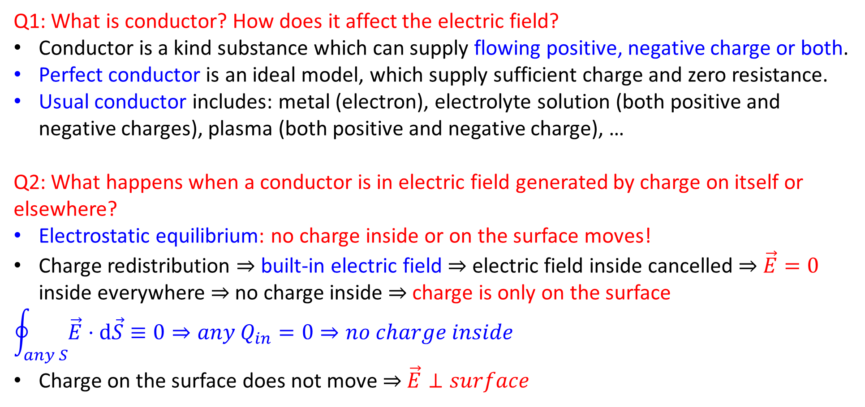
Q1: What is conductor? How does it affect the electric field?
Conductor is a kind substance which can supply flowing positive, negative charge or both.
Perfect conductor is an ideal model, which supply sufficient charge and zero resistance.
Usual conductor includes: metal (electron), electrolyte solution (both positive and negative charges), plasma (both positive and negative charge), …
Q2: What happens when a conductor is in electric field generated by charge on itself or elsewhere?
Electrostatic equilibrium: no charge inside or on the surface moves!
Charge redistribution $⇒$ built-in electric field $⇒$ electric field inside cancelled $⇒$ $\vec{E}=0$ inside everywhere $⇒$ no charge inside $⇒$ charge is only on the surface
$$\oint_{any S}{\vec{E}⋅d\vec{S}}≡0⇒any Q_{in}=0⇒no charge inside$$
Charge on the surface does not move $⇒$ $\vec{E}⊥surface$
E₀
Key feature: no charge moves!

Slide 3
Q3: To a conductor, what is inside?
Outward normal
Outward normal
Outside
Outside
Inside
Outside
Inside
Outward normal
Outward normal: pointing from conductor to other

Slide 4
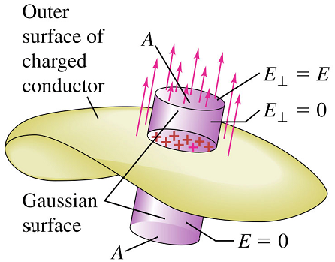

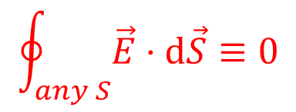




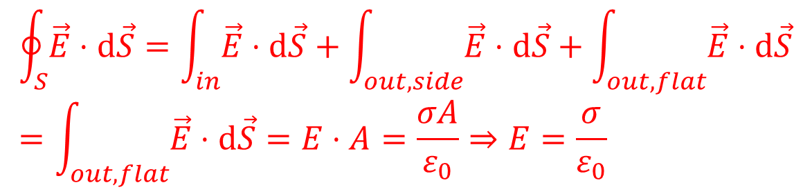
Q4: Why do we say conductor as a situation of using Gauss’s Law to calculate $\vec{E}$?
Inside the conductor
Outside and near the conductor
$$E=\frac{σ}{ε_{0}}$$
Gaussian surface
$$\vec{E}=0$$
$$S_{1}$$
$$S_{2}$$
$$S_{3}$$
$$\oint_{any S}{\vec{E}⋅d\vec{S}}≡0$$
$$\oint_{S}{\vec{E}⋅d\vec{S}}=\int_{in}{\vec{E}⋅d\vec{S}}+\int_{out,side}{\vec{E}⋅d\vec{S}}+\int_{out,flat}{\vec{E}⋅d\vec{S}}=\int_{out,flat}{\vec{E}⋅d\vec{S}}=E⋅A=\frac{σA}{ε_{0}}⇒E=\frac{σ}{ε_{0}}$$
It’s very easy to calculate electric flux!
It’s very easy to calculate electric flux!

Slide 5
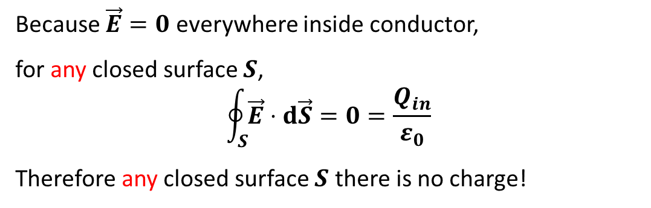

Q5: What is the charge distribution on a conductor?
Case 1: solid charged conductor without hole
All the charges are on the surface
Case 2: holey conductor charged by $Q$ without charge in the hole
All the charges are on outer surface
The reason is similar to case 1
+
+
+
+
+
Because $\vec{E}=0$ everywhere inside conductor,
for any closed surface $S$,
$$\oint_{S}{\vec{E}⋅d\vec{S}}=0=\frac{Q_{in}}{ε_{0}}$$
Therefore any closed surface $S$ there is no charge!
q
+
+
+
+
+
+
+
+
+
+
Q
Q
+
+
+
+
+

Slide 6
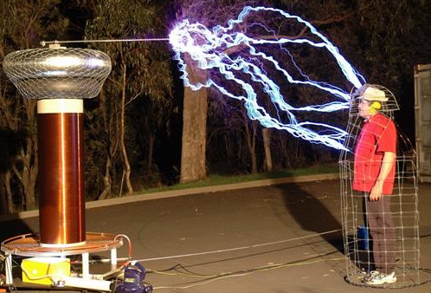



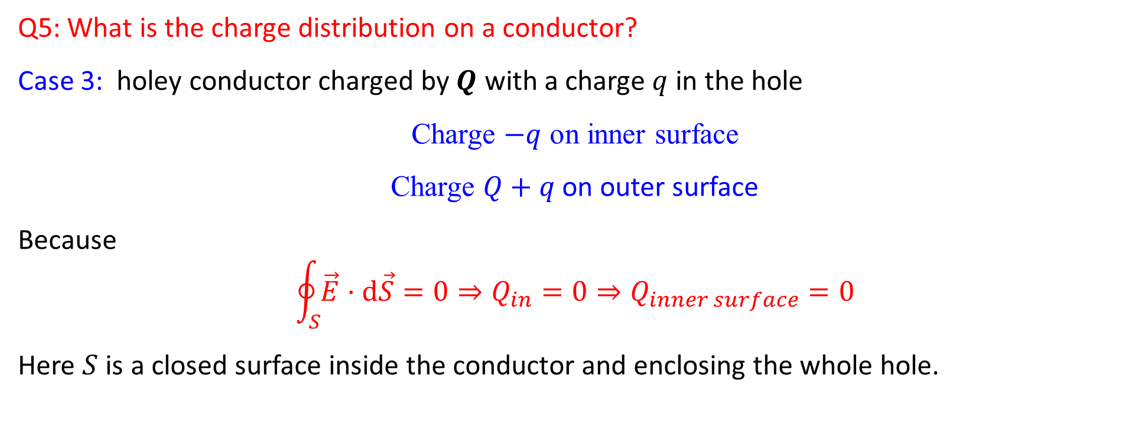





Q5: What is the charge distribution on a conductor?
Case 3: holey conductor charged by $Q$ with a charge $q$ in the hole
Charge $−q$ on inner surface
Charge $Q+q$ on outer surface
Because
$$\oint_{S}{\vec{E}⋅d\vec{S}}=0⇒Q_{in}=0⇒Q_{inner surface}=0$$
Here $S$ is a closed surface inside the conductor and enclosing the whole hole.
+
+
$$\vec{E}=0$$
+
+
$$−$$
$$−q$$
$$−$$
$$−$$
+
Q
Q
$$−$$
+q
$$−$$
q
+
$$−$$
+
$$−$$
+
+
+
Gaussian surface
Faraday cage
Electrostatic shielding
E = 0
A body placed inside the cavity of conductor will not be affected by the electric field outside.
q

Slide 7







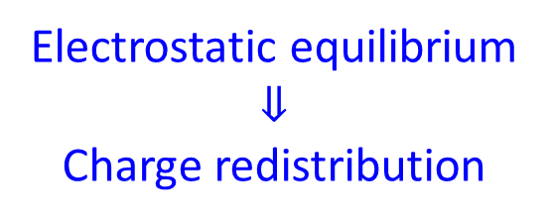






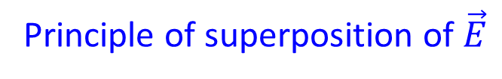



Q6: How to deal with problems involving conductor?
+Q
+
+Q+q
+
+Q+q
+
+
+
+
+
+
$$−$$
$$−$$
$$−$$
$$−$$
$$−$$
$$−$$
+
$$−$$
$$−$$
+
+
$$−$$
+
$$−$$
+q
+q
$$−$$
+
+q
$$−$$
+
$$−$$
$$−$$
$$−$$
$$−$$
+
$$−$$
$$−$$
+
+
$$−$$
$$−$$
+
+
+
+
+
+
+
+
+
+
+
Initial state
Electrostatic equilibrium
$$⇓$$
Charge redistribution
Charges and charged surface
Principle of superposition of $\vec{E}$

Slide 8
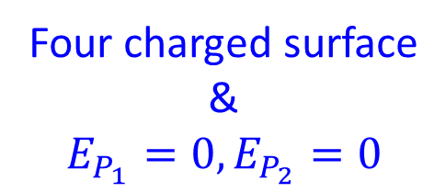
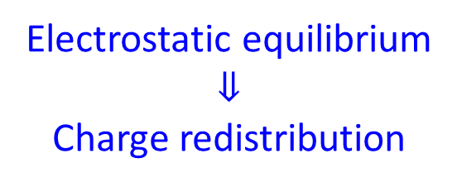
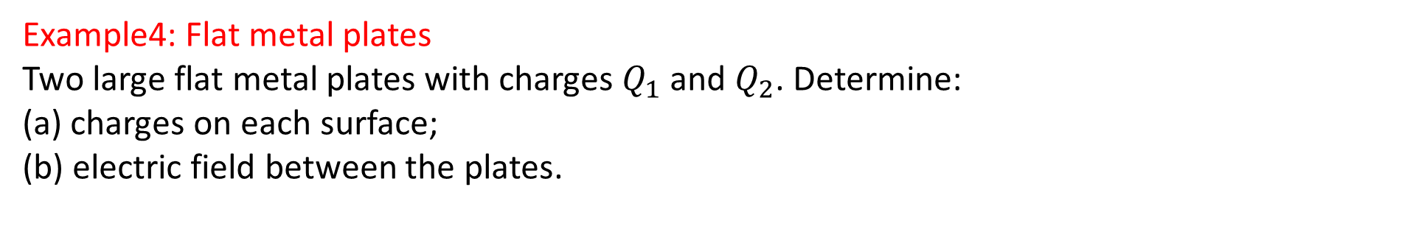
Example4: Flat metal plates
Two large flat metal plates with charges $Q_{1}$ and $Q_{2}$. Determine:
(a) charges on each surface;
(b) electric field between the plates.
Initial state
Electrostatic equilibrium
$$⇓$$
Charge redistribution
Four charged surface
&
$$E_{P_{1}}=0, E_{P_{2}}=0$$

Slide 9
Example4: Flat metal plates
Two large flat metal plates with charges $Q_{1}$ and $Q_{2}$. Determine:
(a) charges on each surface;
(b) electric field between the plates.
Each charged plane generates two uniform field!
Solution:
(a)
(b) E between plates:
Four charged surface
&
$$E_{P_{1}}=0, E_{P_{2}}=0$$

